Slide 1
HEAD LIGHTS
FHI, an overview
Hot topics
Dutch Healthcare System + Figures
Trends

Slide 2
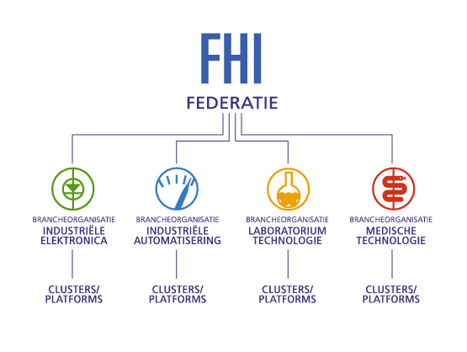
FHI, an overview
Umbrella-organisation for companies in the Netherlands that are active in the supply and application of different technologies in industry and healthcare
Four main groups or “branches”: Industrial Electronics, Industrial Automation, Laboratory Technology and Medical Technology

Slide 3
FHI, an overview
Economic research / statistics
Trade fairs & conferences
Social policy (HRM, salary surveys)
Purchase and delivery conditions
Technology policy (stimulate the economic climate)
Legal support
Joint purchase of services (cost benefits/discount fees for example product liability,
Car, absenteeism and pension insurance etc)
Provision of information, workshops
Publicity

Slide 4
Organizational overview

Slide 5
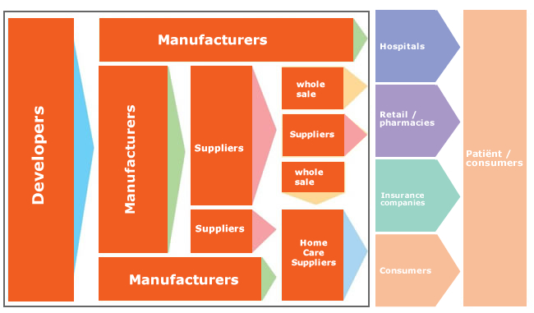
Supply Chain FHI Medical Technology

Slide 6
FHI, an overview
140 members
Medical devices / medical equipment
Large and small companies
Markets: hospitals, elderly, homecare/insurance, consumers
Board: Medisize, Entermed, Siemens, Mediq, Drager, Fresenius, Mathot
15 Clusters

Slide 7
Clusters
Pacemakers, ICD’s
DIS Diabetes, Incontinence, Stoma, Wound
Ultrasound
Home Care
Infusion
Insulin pumps
- interventional cardiology
AED
Endoscopie
Gases
MRI, CT
Telemedicine
Lamps-pendants-Surgery tables
Elektro Medical equipment
Sterilisation/Desinfection

Slide 8
Hot Topics
Code of Ethical Business Practice
Reimbursement
Investment, maintenance & user knowledge medical equipment
Medical Device Regulation (MDR)
Counterfeit

Slide 9
GMH - Code of Conduct Medical Devices
Advertising and promotion are permitted, but the basic principle applied is that the patient/client must be able to trust that decisions concerning a certain device or technology are made on honest grounds, related to patient care. This means on the basis of good, reliable information and without undesirable financial incentives.
The regulations or behaviour recorded in this Code of Conduct are intended - in addition to the legislation in force - to give more substance to careful, transparent and responsible interaction between suppliers of medical devices and the parties involved in the decision-making process regarding their purchase and/or use, irrespective of the setting in which they are used.After all, optimal interaction is founded on reciprocity; that which one party may not offer or give, the other party may not request or accept.

Slide 10
Reimbursement Government is systematically eliminating non-essential services in an attempt to reduce overall healthcare spend and hospitals remain under constant pressure to manage their budgets more efficiently. Our message: Don’t save on Medical Devices - Medical devices can save the healthcare system money

Slide 11
Reimbursement Zorginstituut Nederland (ZiN), is an independent government organization, has a crucial role to coordinate the funding activities and the implementation of Zvw and AWBZ. It also plays an important role to coordinate between the parties who determine policy and who implements it. Netherlands uses a DBC/DOT reimbursement system, a new case-mix reimbursement system for hospitals and medical specialist care, which was introduced in the Netherlands in 2006.
At this moment it’s difficult to get market access with new expensive medical devices: first prove it
(Evidence-based Health Policy, Evidence-based Economic Evaluation, Randomized Clinical Trials etc)

Slide 12
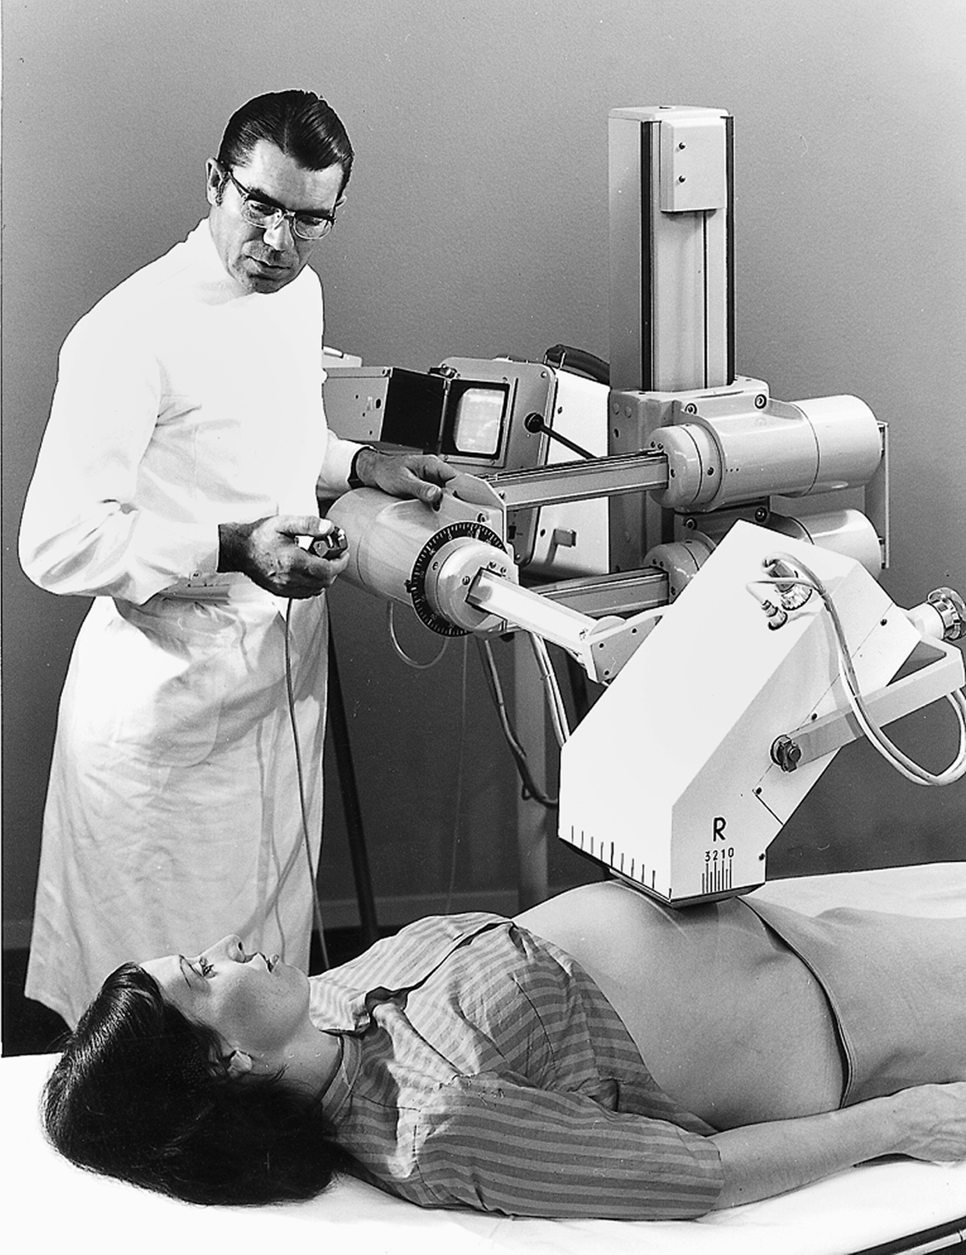
Medical equipment
depreciation period >10 years
1.7% of the total healthcare expenditure
Old
Problems with maintenance
Problems with knowledge

Slide 13
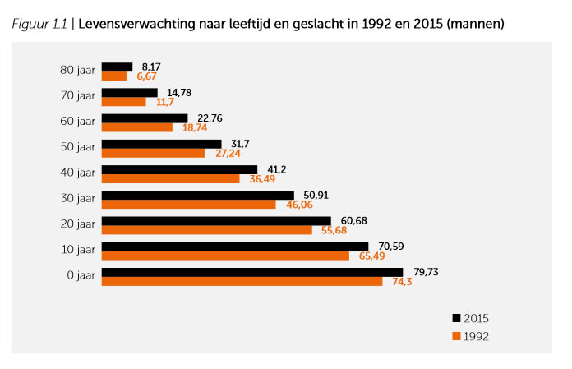
Dutch Healthcare System + Figures

Slide 14
Dutch Healthcare System + Figures

Slide 15
Dutch Healthcare System + Figures

Slide 16
Dutch Healthcare System + Figures

Slide 17
Dutch Healthcare System + Figures

Slide 18
Dutch Healthcare System + Figures

Slide 19
Dutch Healthcare System + Figures

Slide 20
Dutch Healthcare System + Figures

Slide 21
Dutch Healthcare System + Figures

Slide 22
Dutch Healthcare System + Figures

Slide 23
Dutch Healthcare System + Figures

Slide 24
Dutch Healthcare System + Figures

Slide 25
Dutch Healthcare System + Figures

Slide 26
Dutch Healthcare System + Figures

Slide 27
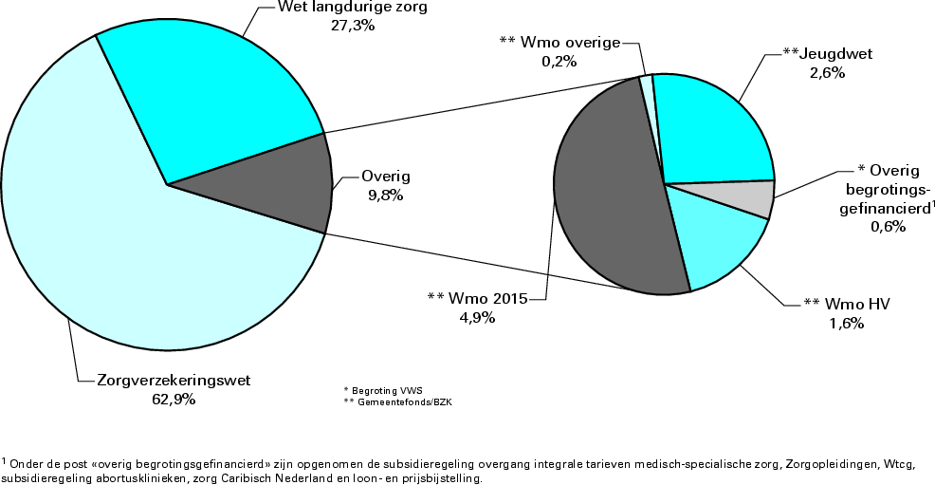
Healthcare expenditure
Every dutch citizen has a mandatory healthcare insurance policy
• this is the so called: “base policy”: a minimum amount of treatments and expenditures
• this policy deals with the family physicians, hospital care and pharmaceutical expenditures
• additional insurance is optional
Besides we have the Wlz (wet langdurige zorg) and Wmo (Wet maatschappelijke ondersteuning) that is a law for special healthcare costs. The main components are mental healthcare, care for the disabled and care for the elderly

Slide 29
Spending growth is mainly due to an increase in the volume of care: there is more care is delivered. Since 2002 there is a substantial volume growth seen at 4.2% against an average price increase of 1.6%
Annually the number of in-patient hospitalizations growth by 3% and day hospitalizations by 10%. Comparing with other EU countries the volume of hospitalizations is in the Netherlands relatively low.

Slide 30
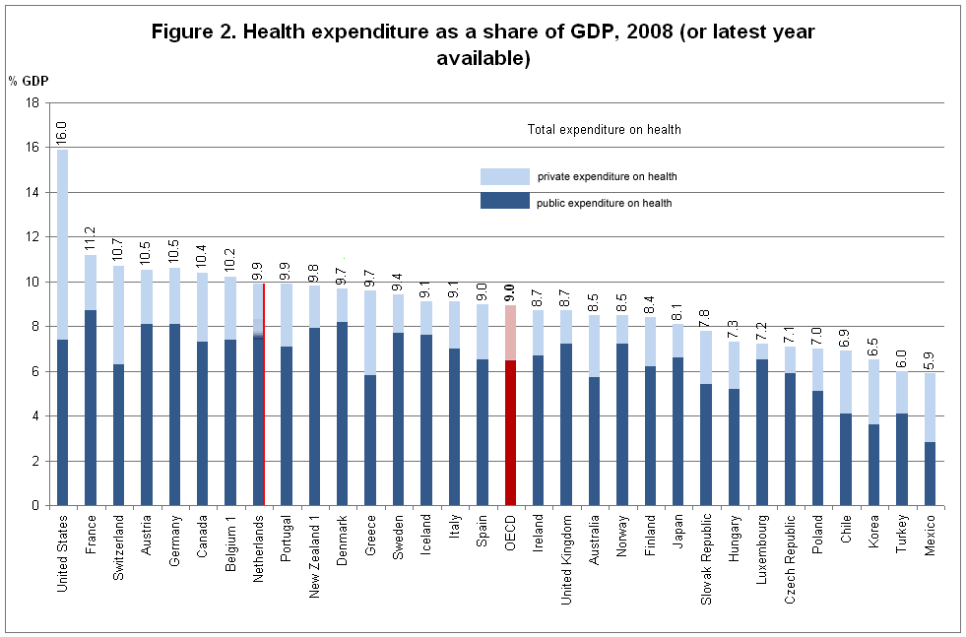

Slide 31
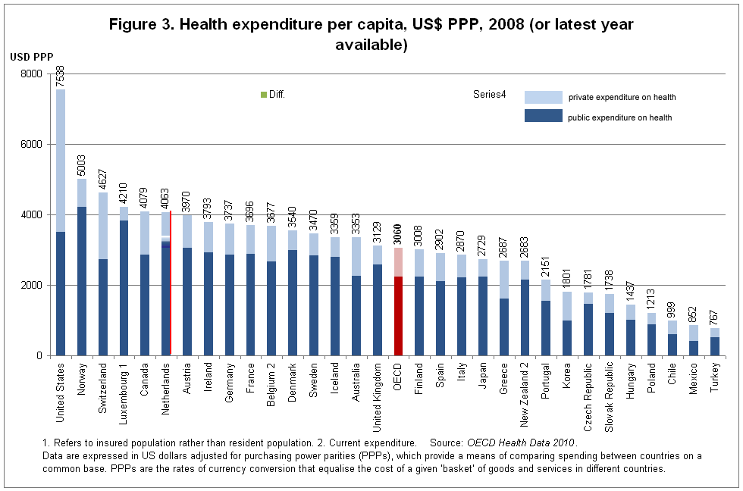

Slide 32
Outcome of investment
Our strengths…
In comparison with other EU countries The Netherlands scores well on heart disease, injuries, physical activity and overweight
and some quality of care indicators
Good healthcare access for everybody
Our weaknesses…
Dutch mortality rates for cancer and respiratory disease are worse than average, as is smoking, ecstasy use and breastfeeding
The Netherlands scores particularly poorly on mortality from all cancers and from respiratory diseases, which includes COPD (especially for women and for higher age groups).

Slide 33
The Dutch health insurance reform
Managed competition between health insurance organizations and between health care providers
Comparative quality information to
- inform patient choice
- provide insurers with purchasing information
- and providers with improvement information

Slide 34
The Dutch health insurance reform
• formerly a budget system
• from 2005 transition to DBC-system
DBC = diagnosis treatment combination
A -segment: only the financing, not for the budget funding – (only for some high-end procedures/care)
B - segment: negotiabel prices between hospital and insurers
• costs of capital
up till 2009 no risks on these expenditures for hospitals
From 2011 capital expenditures incorporated in the costs of the DBC’s

Slide 35
Actors and markets in the Dutch health care system since 2006

Slide 36
4 large insurance companies
Consumer/ Patiënt
General practitioner
Farmacy
Hospitals/ ZBC’s
Medical devices
The government is changing the system and giving power to
the healthcare buyers (insurers)
No Level playing field

Slide 37
8 academic 83 general hospital organisations
226 ZBC’s expect In 2015 turnover 5 miljard high volumes, non complex, planned

Slide 38
Financial position of health care organisations
• The profitability of health care institutions fluctuated around 1% between 2006 and 2009;
Approximately 22% of the institutions has weak financial results (BDO benchmark)
• The average solvency of health care institutions is 22% in 2016

Slide 39
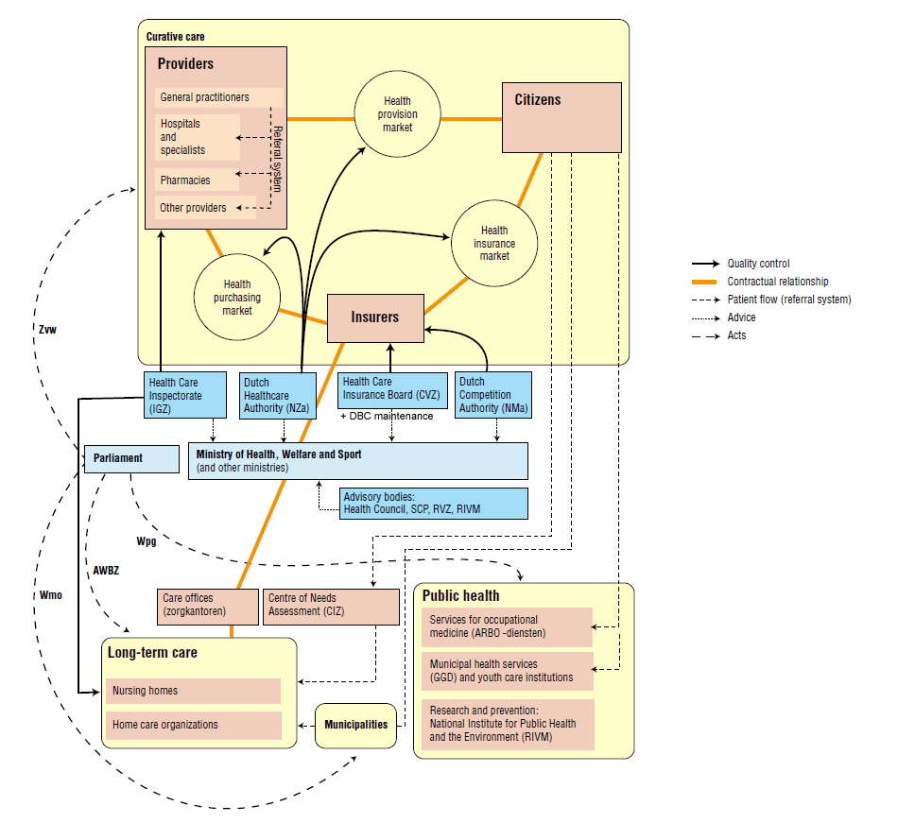
Organizational overview of the Dutch health care system

Slide 40
Trends in Healthcare
• Increasing financial risks for healthcare suppliers
• Increasing demand for quality, from insurers as well as from the public • Increasing need for investment, for instance in ICT and equipment
The need for cost-reductions and delivering patient care at market prices
More central purchasing and parallel imports
Hospitals reduce the number of suppliers
• A trend towards specialised clinics, like the Sint Maartenskliniek • Entering of new, private for-profit healthcare suppliers that play a different game • Private-equity, seeking an entrance in the Dutch healthcare market

Slide 41
Trends in Healthcare
Care and cure providers will need to compete for the favor of both insurers and patients
Inefficient sectors may face major disruption (e.g. hospitals), and new models will emerge as demand is changing and insurers and government are pushing towards increased efficiency and lower costs
The first line (general practitioners) is increasing in importance as gate keeper of Dutch healthcare – chain DBC’s (GP’s/CareGroups are the main contractor for diabetes, cardiovasculair riskmanagement, COPD).
Reduction of coverage of base insurance (treatment and products), while consumer’s own contributions are increased
In specific segments, the government intervenes by imposing price/volume caps on specific services or products

Slide 43
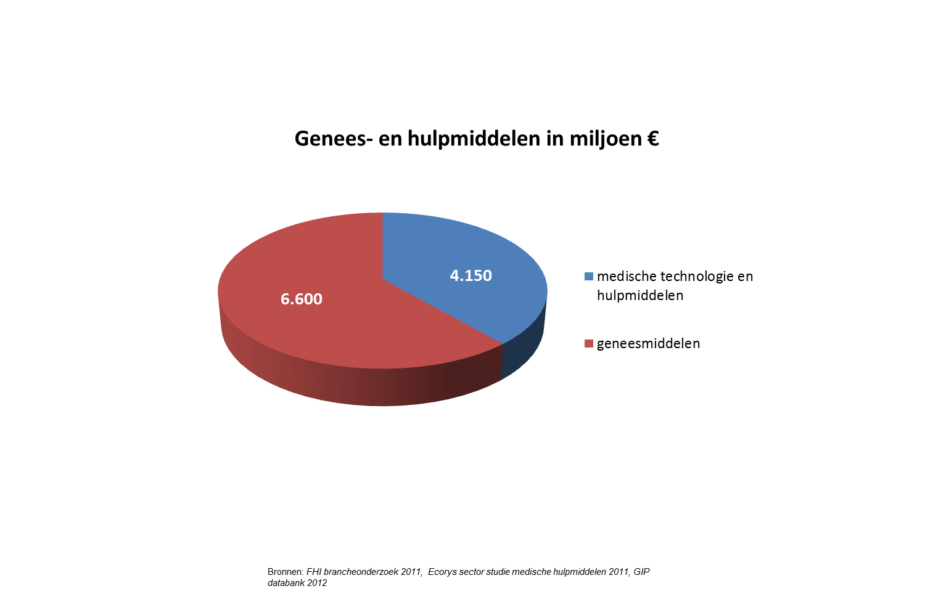

Slide 44
Intramural
Het algemene beeld dat er sprake is van een stagnerende markt. Met name investeringsstop in kapitaalgoederen. Overall nog geen duidelijke tekenen van herstel naar oude niveau.
Onduidelijkheid over fusies, specialisaties, volume, contract verzekeraar
Banken financieren moeizaam
Overheveling dure geneesmiddelen mogelijk invloed
* Sterke prijsdruk
* Wir war van inkoopcombinaties (weinig garantie op volume)

Slide 45
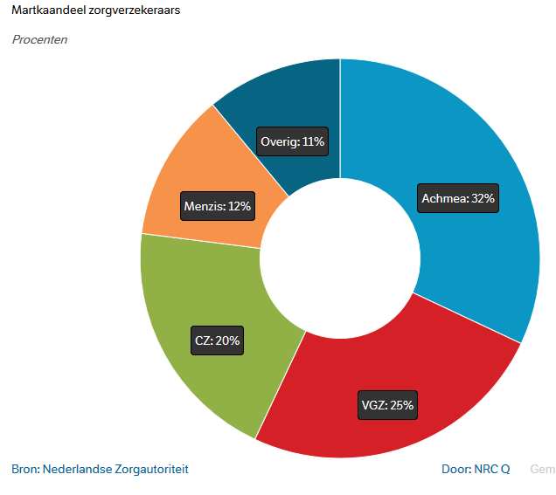
Market share insurance companies

Slide 46
Medical devices industry faces biggest regulatory game changers in EU since decades
Get it right or get it wrong – mistakes will impact your company severely

Slide 47
Status update: so what was changed?
Scientific advice also possible for certain IIb devices
Coordinated assessment in multi-state trials initial period extended to 7 years
Clarification of vigilance for the devices in the sell-off transition period of 5 years - member states organise vigilance for themselves
Changes in UDI requirements for custom made devices
Class IIb and III devices need UDI allocated prior to application for conformity assessment
Transition regime requirements for MDD/AIMDD certificates after date of application (no significant changes in the design and intended purpose. However, the requirements of this Regulation relating to post-market surveillance, market surveillance, vigilance, registration of economic operators and of devices shall apply in place of the corresponding requirements in those Directives)

Slide 48
Key MDR impacts and gaps
Item | Impact
Clinical Evidence | More pre- and post-market data, PMS plans, frequently updated CERs
Limited Equivalence | Discontinuation or fresh clinical data
Devices with a long history of safe use | Invest in pre- and post-market clinical Discontinue or invest
Post-Market Monitoring | More PMCF, PSURS, annual CERs New vigilance and annual reporting More transparency, user and patient access
Scrutiny / ‘clinical evaluation consultation procedure’ | Unpredictable launch, delay, conflicting reviews

Slide 49
Key MDR impacts and gaps (2)
Item | Impact
Reprocessing Regulation | Increased or decreased industry involvement and level of patient safety pending outcome
Technical files to be constantly up to date and readily searchable | New content plus IT system with real time data from various systems incl. suppliers
Economic operators regulated | Integrate in manufacturers QS or duplication of compliance activities

Slide 50
Key MDR impacts and gaps (3)
Item | Impact
Eudamed / UDI | IT solutions, pre- I post-market data, (re-) registration fees, labeling, national vs. EU database?
Transitional Period | Prioritize re-launch, MDD I MDR decision, capacity, talent, operational readiness of NB’s
Restricted Substances Justification | Product- Component Assessment Tracking systems I product design
Administrative Burden | Eudamed interaction, each and every label to be updated Implant cards for all implants, UDI- DoC link

Slide 51
MDR and Eudamed
Eudamed will contain integrated electronic systems on
European UDI
Registration of devices and economic operators
Scrutiny applications (possibly other conformity assessments)
Certificates issued by notified bodies
Clinical investigations
Vigilance
Market surveillance activities
Registration of subsidiaries and subcontractors of notified bodies
A large part of the information in Eudamed will become publicly available in accordance with the provisions regarding each part of the electronic system
Plan for interaction strategy with Eudamed and national authorities (latter for obtaining manufacturer and economic operator SRNs)

Slide 52
Notified bodies
Stronger supervision on Notified Bodies
Continuation of joint assessment; handbook transcribed into NB annex in MDR
Scrutiny on high risk devices
Review of notified body assessment of technical documentation and clinical evaluation
Thorough testing and regular checks on manufacturers
Unannounced factory inspections
Rotation of notified body staff involved in assessment
Adoption of common technical specifications
Notified Body numbers continue to drop
Resources will become critical in transition

Slide 53
Most important for manufacturer
Article 29-31: Requirements relating to Notified Bodies
All Notified Bodies must be re-designated
Joint Assessment
Article 42: Conformity Assessment Procedure
Unannounced Audits and testing of samples
Article 44: Mechanism for scrutiny of certain conformity assessments
For class III products and class IIb active devices that supply medicines to the human body
Peer-review of an expert panel on an European level
Article 60: Post-market surveillance system of the manufacturer
Periodic post-market surveillance reports for class III products and class IIb active devices that supply medicines to the human body
Reviewed by Notified Body and make available to Competent Authorities

Slide 54
Most important for manufacturer: certificates
Entry into force
Date of notification under MDR
Date of application
[1 year expectation]
Cerificates can be granted under MDD / AIMDD (but mind the transitional regime limitations on their duration)
Certificates under MDR (normal duration)
Transitional period (3 years)

Slide 55
Transition
Entry into force
Date of application
DoA + 4 years
DoA + 5 years
First certificate 94 (2) 2nd
[entry into force of MDR to DoA + 2]
Last 94 (2) 2nd certificate
[DoA -1 to DoA +4]
Transitional period (3 years)
94 (2) grace period with certificate(4 years)
Lawfully made available under MDD or AIMDD
94 (3a) grace period when lawful on the market on DoA (5 years)

